Slide 1
Summer 2026
Water Safety

Slide 2
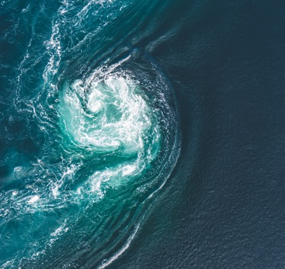



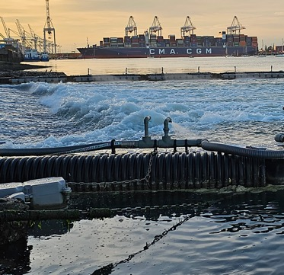
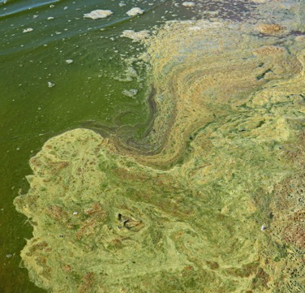
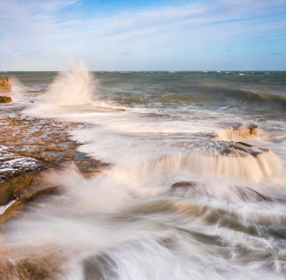
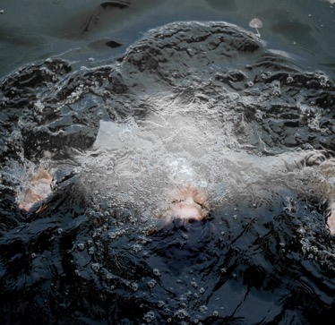

Stay safe and do not enter the water
There are many dangers in water, including…
Unpredictable currents
Ship movements and their wash
Underwater obstacles and entanglement hazards
Limited visibility
Underwater sluices
Blue green algae
Deep water and sudden changes in depth
Cold water shock
2

Slide 3
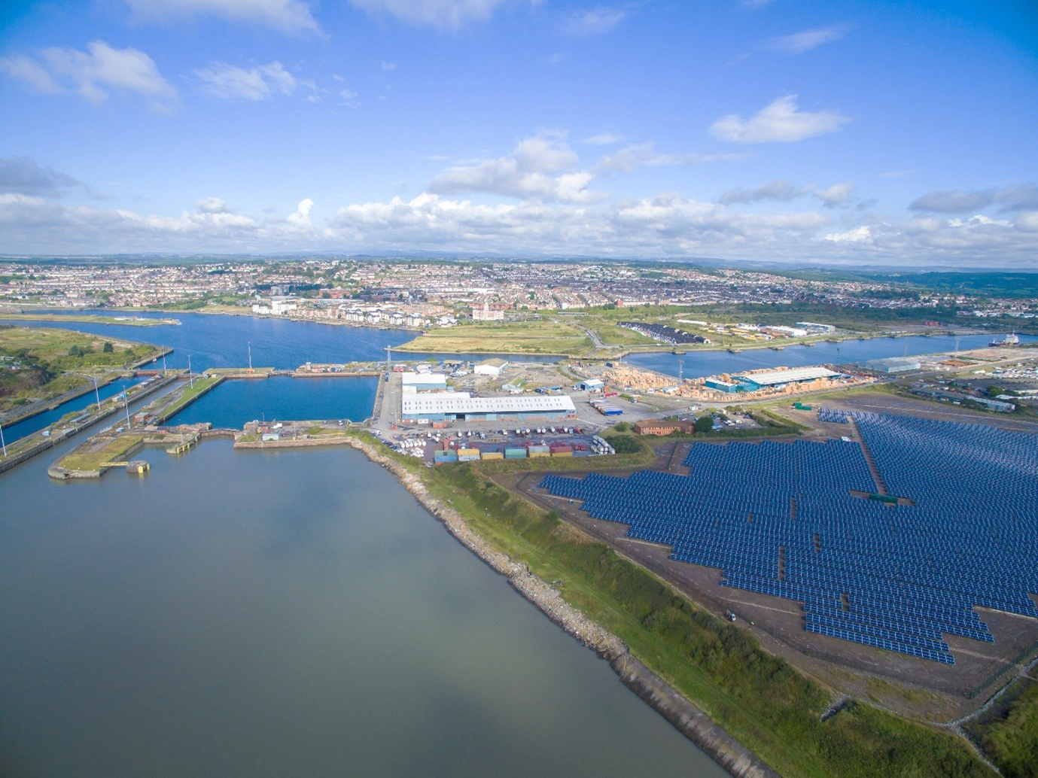
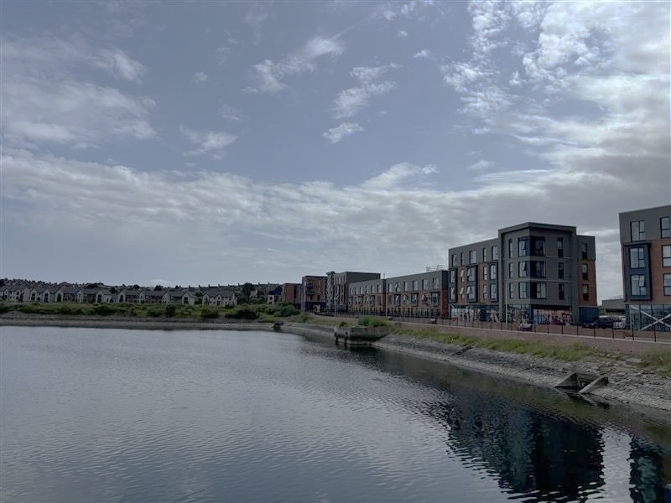
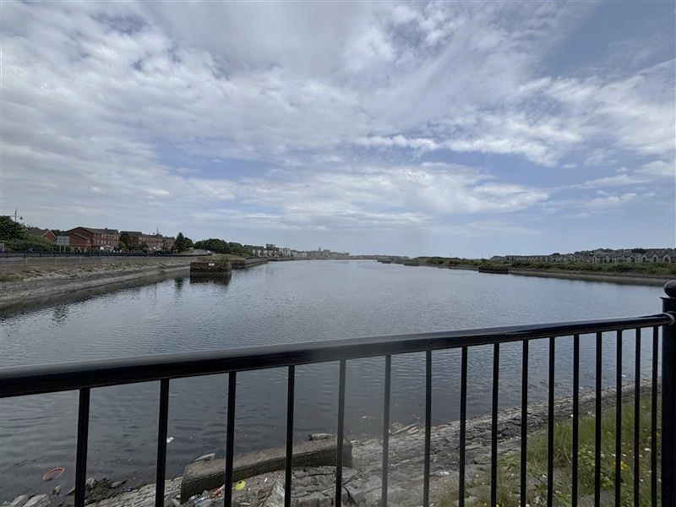
The Port of Barry
The Port of Barry handles many products such as liquid bulks, steel, scrap metal, containers, dry bulks, coal, and aggregates. It is very dangerous to swim in the Port of Barry.
Do not swim in the Port of Barry
3

Slide 4
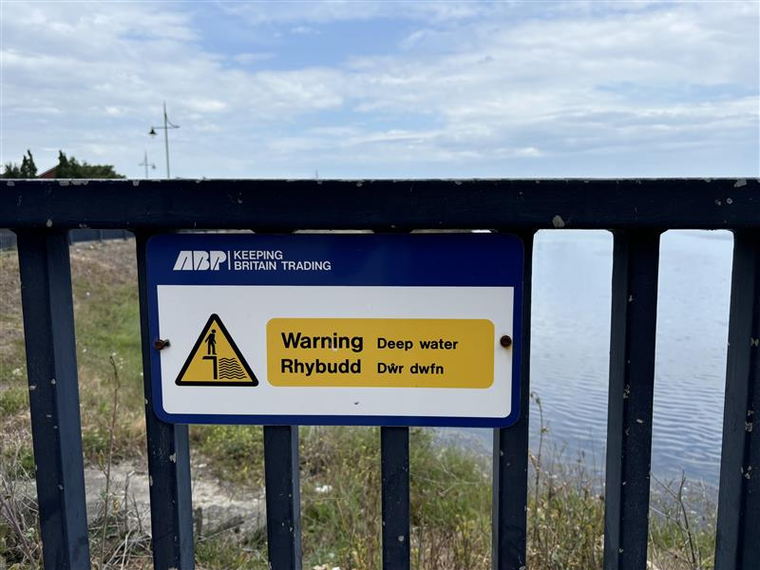
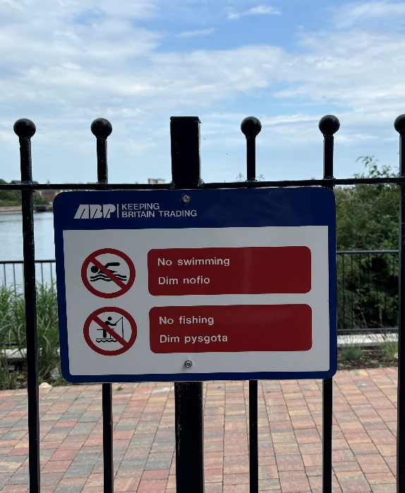
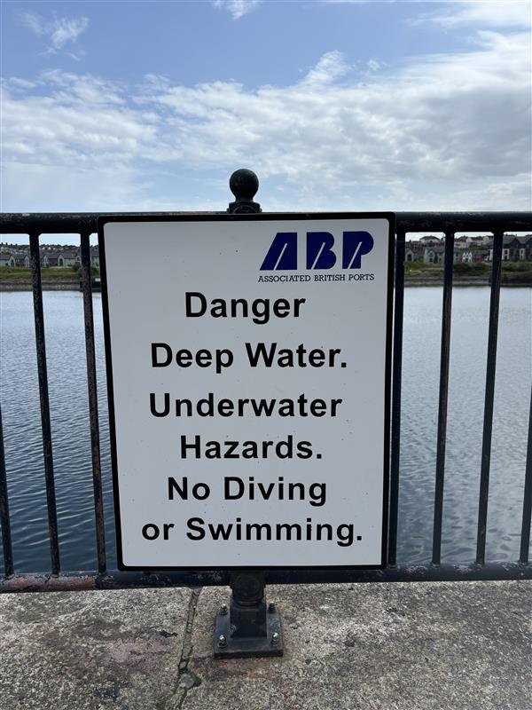
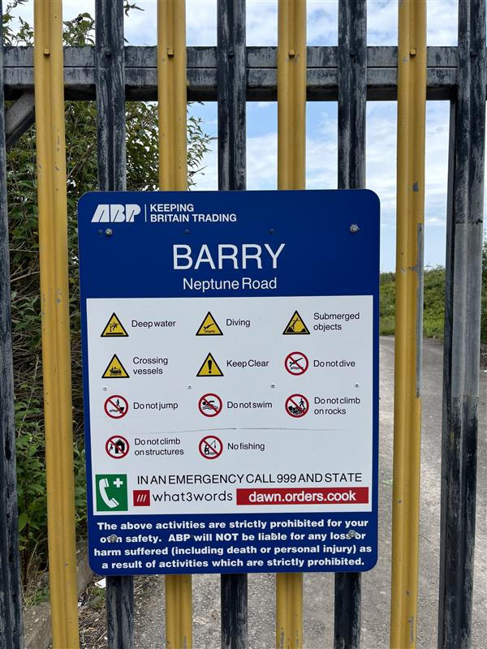
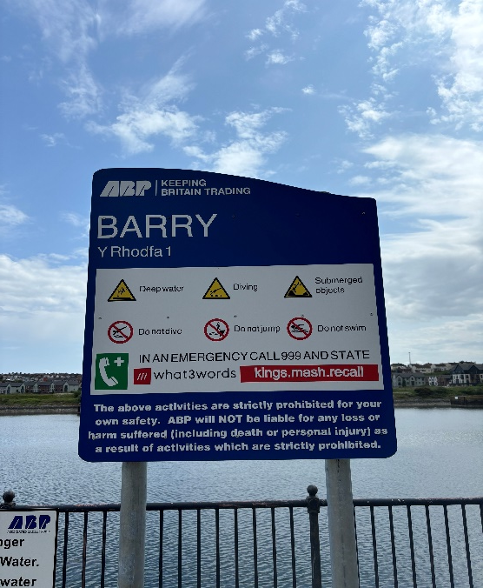
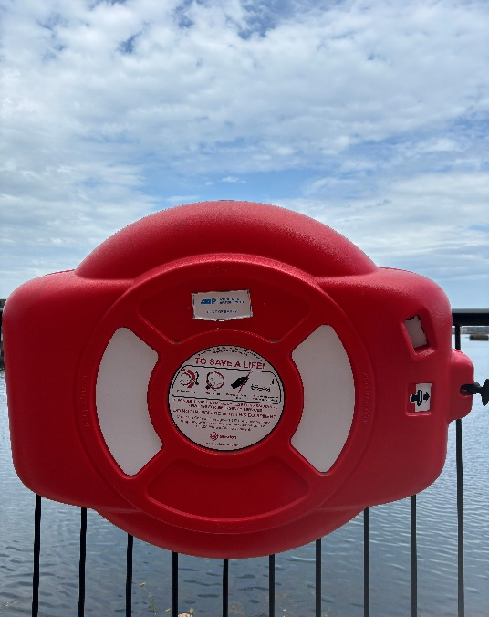
Please adhere to the water safety signage at Barry
4

Slide 5
Beaches in South Wales with RNLI lifeguard patrol
RNLI lifeguards patrol daily from 23rd May to 6th September 2026, 10am–6pm. Below is a list of some nearby beaches to enjoy the nice weather
Aberavon Beach
Caswell Beach
Coney Beach (Sandy Bay)
Langland Beach
Llantwit Major Beach
Ogmore Beach
Pembrey Beach
Port Eynon Beach
Rest Bay Beach
Southerndown Beach
Three Cliffs Beach
Trecco Bay Beach
Whitmore Bay Beach (Barry)
Full list of beaches with RNLI lifeguard presence can be found here.
5

Slide 6






RNLI Float to Live Campaign
Follow these five simple steps from the RNLI if you fall into the water
1 | Tilt your head back submerging your ears.
2 | Relax and control your breathing.
3 | Move your hands and legs to help you stay afloat.
4 | Your legs may sink – that's OK everyone floats differently.
5 | Find your float by practising at a supervised location.

Slide 7

Stay safe and do not enter the water in ports
Summer 2026
7

