Slide 1
Cowbridge Litter Pick
Information Presentation

Slide 2
🌍 Keeping the Vale Beautiful: Why We Say NO to Litter!
From the beautiful beaches of Barry, Penarth, and Sully to the historic streets of Cowbridge and Llantwit Major, the Vale of Glamorgan is an amazing place to live and go to school. But litter is putting our beautiful home at risk.
Here is exactly why dropping litter is a big problem—and how our school can make a massive difference.

Slide 3
🐿️ The Danger to Our Local Wildlife
When we drop a crisp packet, a plastic bottle, or a sweet wrapper, it doesn’t just sit there. It becomes a deadly hazard for the animals we share the Vale with—from hedgehogs and garden birds to marine life on our coastline.
Trapped and Tangled: Small mammals like mice and voles crawl inside discarded drink cans or bottles looking for food, get stuck, and cannot get out. Rubber bands and plastic rings can get tangled around birds, preventing them from flying or growing properly.
Mistaken for Food: Animals cannot tell the difference between plastic and a snack. Sea birds on our beaches often swallow bits of plastic, which fills their stomachs and stops them from eating real food.
From Streets to the Sea: Litter dropped right here on our school yard or local streets gets blown into drains and streams. These flow directly into the Bristol Channel, harming marine life like seals and fish.

Slide 4
🚜 The Harm to Our Environment
Litter destroys the natural beauty of the Vale of Glamorgan, but the invisible damage is even worse.
The "Forever" Problem: Plastic litter never truly disappears. A plastic bottle dropped today can take up to 450 years to break down. Even then, it just breaks into tiny "microplastics" that poison the soil and water.
Encouraging Pests: Dropped food waste and packaging attract rats and pests to areas where we play and walk, making our school and local parks less safe and hygienic.

Slide 5
💰 The Shocking Financial Cost
Cleaning up litter isn't free. In fact, it costs an absolute fortune—money that comes out of the pockets of everyone's families through local taxes.
Did you know? > Across Wales, it costs an estimated £3.5 million every single year for local councils to clear up roadside and community litter.
In the Vale of Glamorgan, the Council collects hundreds of tonnes of litter annually. Every pound spent on sending out trucks and workers to pick up rubbish from hedges, parks, and pavements is money that cannot be spent on things our community actually needs, such as:
Improving our school buildings and equipment.
Building better skateparks, play areas, and sports pitches.
Fixing local roads and improving parks.
Plus, dropping litter is a crime! Anyone caught dropping litter in the Vale faces a hefty on-the-spot fine.

Slide 6
🎒 What Can Our School Do?
We are lucky to be part of a community that cares. With dozens of schools in the Vale actively taking part in the Keep Wales Tidy Eco-Schools programme, here is how we can do our bit:
The "Take it Home" Rule: If a bin is full, or if there isn't one nearby, never just leave your rubbish on top of the bin or on the floor. Put it in your bag and dispose of it at home.
Become Litter Heroes: Join or set up a school "Litter Free Zone" or an Eco-Committee to do regular, safe litter picks around the school grounds and local lanes using proper litter-pickers.
Reduce and Reuse: Try to bring snacks in reusable containers rather than single-use plastic wrap or packets. Less packaging means less litter!

Slide 7
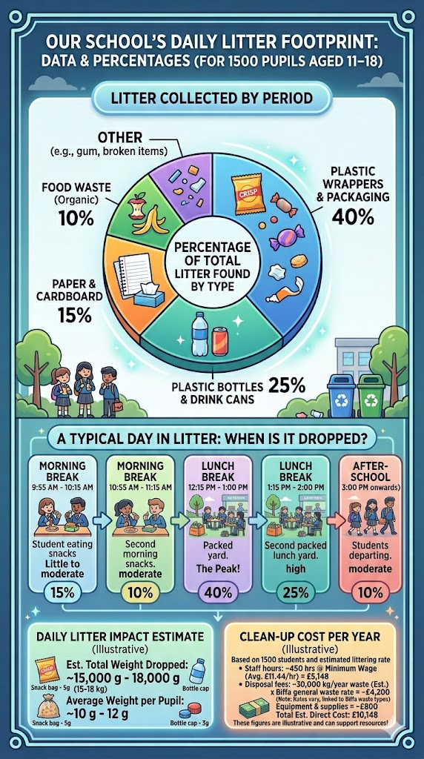
What does this graph tell us about Cowbridge School?

Slide 8
What does this tell us about Cowbridge School?

Slide 9
Why is this information important to know?
Following these shocking statistics, every form class will be participating in a daily clean up of our school grounds during form time.
You will receive gloves and bin bags to aid you in your clean up.
The groups that collect the most amount of rubbish wins (prize yet to be revealed!)

Slide 10
 | FORM CLASS 1 | FORM CLASS 2 | Location to Litter Pick
Monday 15th June | 9.2 Miss George | 9.4 Mr Mohamed | Car Park/ Field
Tuesday 16th June | 7.4 Miss Moore | 7.5 Miss Harvey | Piazza/ Gym/ E/B/D Block area
Wednesday 17th June | 8.5 Mrs Srithong | 9.3 Dr Brown | Back Fields (Behind Staff Car Park)
Thursday 18th June | 7.7 Mrs Cash | 7.8 Mr Bowen | Inside A Block - Lockers, LRC, Computer Areas

Slide 11
 | FORM CLASS 1 | FORM CLASS 2 | Location to Litter Pick
Monday 22nd June | 9.6 Mr Morgan | 12.1 Mrs Jenkins | Car Park/ Field
Tuesday 23rd June | 9.7 Miss Pring | 10.4 Mrs Williams | Piazza/ Gym/ E/B/D Block area
Wednesday 24th June | 8.4 Mr Griffiths | 12.2 Mrs Middleton, Mrs Best, Mrs Stoneham | Back Fields (Behind Staff Car Park)
Thursday 25th June | 8.1 Miss Whittaker | 7.3 Mr Watt | Piazza/ Gym/ E/B/D Block area
Friday 26th June | 8.2 Mrs Ireland | 9.8 Mr Morgan | Back Fields (Behind Staff Car Park)

Slide 12
 | FORM CLASS 1 | FORM CLASS 2 | Location to Litter Pick
Monday 29th June | 8.3 Mr Hiett | 10.7 Mrs Evans | Car Park/ Field
Tuesday 30th June | 7.6 Mrs Rowe | 10.5 Mr Cox | Piazza/ Gym/ E/B/D Block area
Wednesday 1st July | 10.1 Miss Powlson | 10.3 Mrs Rule | Back Fields (Behind Staff Car Park)
Thursday 2nd July | 8.7 Mr Phillips | 12.3 Mrs Phillips | Piazza/ Gym/ E/B/D Block area
Friday 3rd July | 8.6 Mr Williams | 12.4 Mr Rees | Back Fields (Behind Staff Car Park)

Slide 13
 | FORM CLASS 1 | FORM CLASS 2 | Location to Litter Pick
Monday 6th July | 10.8 Mrs Hill | 10.6 Miss Wheatley | Car Park/ Field
Tuesday 7th July | 7.2 Mr Edmunds | 7.1 Miss Davies | Piazza/ Gym/ E/B/D Block area
Wednesday 8th July | 8.8 Mr Doey | 10.2 Mr Wrigley | Back Fields (Behind Staff Car Park)
Thursday 9th July | 9.5 Mrs Goncellin | 12.5 Mrs Stoneham, Mrs Thomas | Piazza/ Gym/ E/B/D Block area
Friday 10th July | 9.1 Mrs Richardson, Mrs Bail | 7.7.6 Dr Patterson | Car Park/ Field

